Slide 1

1౦th Class – SOCIAL STUDIES
Paper - 2
WORLD – Map Pointing
www.digitalsocialteacher.in

Slide 2
CONTINENTS - OCEANS

Slide 3
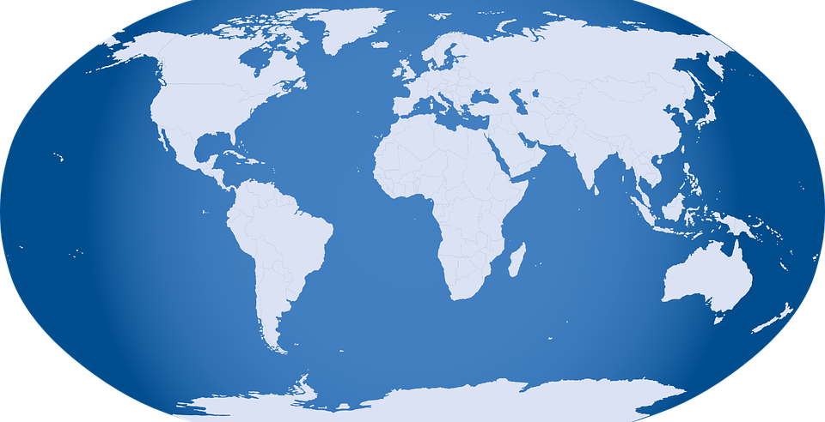
Arctic Ocean
North America
Europe
Asia
Africa
Pacific Ocean
Atlantic Ocean
Indian Ocean
Pacific Ocean
South America
Australia
CONTINENTS - OCEANS
Antarctic Ocean
Antarctica

Slide 4
ASIA

Slide 5
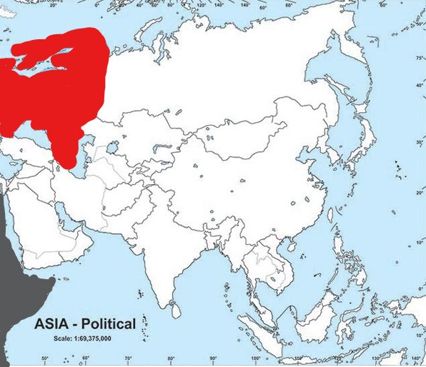
13
1. India
2. Pakistan
3. Myanmar
4. Bangladesh
5. Sri lanka
6. Indonesia
7. Singapore
8. Vietnam
9. China
10. Nepal
11. Bhutan
12. Magnolia
13. Russia
14. Iran
15. Iraq
16. Turky
17. Japan
18. North Koria
19. South Koria
20. Palestine
21. Israel
22. Saudi Arabia
17
Europe
9
12
16
18
19
14
15
21
20
22
1
2
10
11
3
4
8
Africa
5
6
ASIA
7

Slide 6
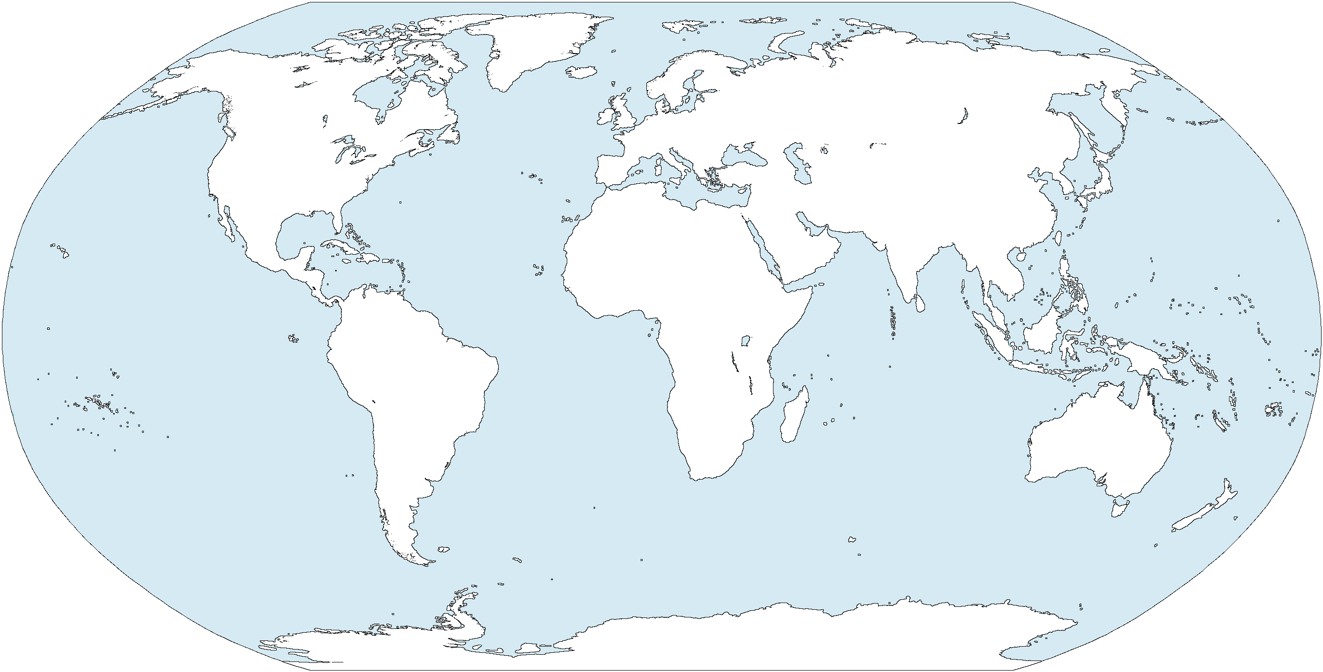
1. India
2. Pakistan
3. Myanmar
4. Bangladesh
5. Sri lanka
6. Indonesia
7. Singapore
8. Vietnam
9. China
10. Nepal
11. Bhutan
11
9
10
2
4
1
3
8
5
7
6

Slide 7
12. Magnolia
13. Russia
14. Iran
15. Iraq
16. Turky
17. Japan
18. North Koria
19. South Koria
20. Palestine
21. Israel
22. Saudi Arabia
13
20
16
12
18
17
15
14
21
22
19

Slide 8
AFRICA

Slide 9
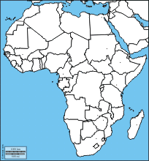
3
1. Egypt
2. Libya
3. Algeria
4. Morocco
5. Tunis
6. Nigeria
7. Cameroon
8. Congo
9. Uganda
10. Angola
11. Namibia
12. South Africa
13. Zimbabwe
14. Zambia
15. Mozambica
16. Tanzania
17. Kenya
18. Ethiopia
19. Somalia
4
5
2
1
6
18
7
19
8
9
17
16
10
14
AFRICA
15
11
13
12

Slide 10
1. Egypt
2. Libya
3. Algeria
4. Morocco
5. Tunis
6. Nigeria
7. Cameroon
8. Congo
9. Uganda
10. Angola
5
4
3
2
1
6
7
8
9
10

Slide 11
11. Namibia
12. South Africa
13. Zimbabwe
14. Zambia
15. Mozambica
16. Tanzania
17. Kenya
18. Ethiopia
19. Somalia
18
19
17
16
14
13
11
12
15

Slide 12
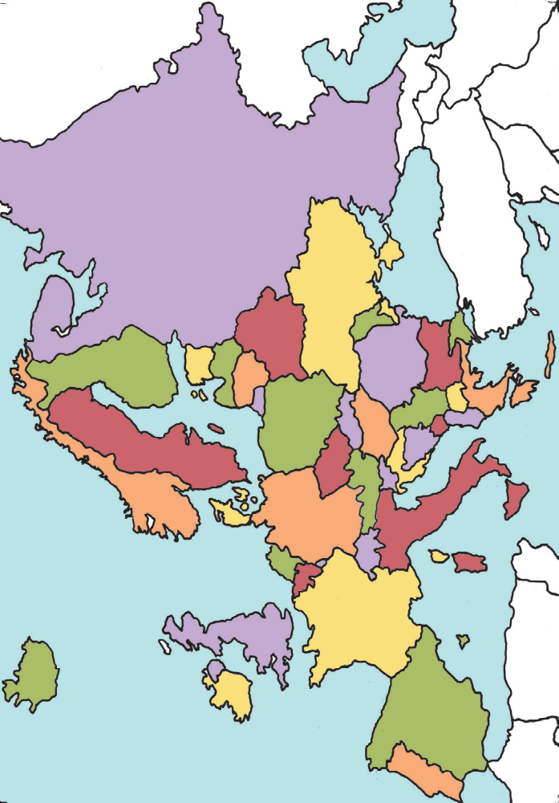
EUROPE

Slide 13
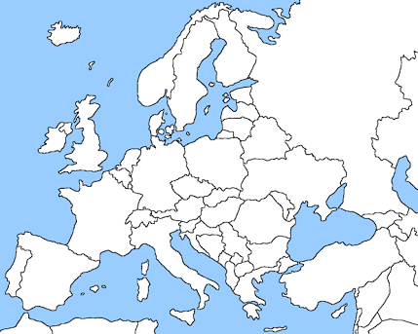
EUROPE
14
17
1. Portugal
2. Spain
3. France
4. Belgium
5. Nederland
6. Germany
7. Poland
8. Denmark
9. Italy
10. Switzerland
11. Austria
12. Britain
13. Ireland
14. Norway
15. Sweden
16. Finland
17. Russia
18. Hungary
19. Serbia
16
15
12
8
13
6
7
5
4
3
11
18
10
9
19
2
1

Slide 14
1. Portugal
2. Spain
3. France
4. Belgium
5. Nederland
6. Germany
7. Poland
8. Denmark
9. Italy
10. Switzerland
8
6
5
4
7
3
2
1
10
9

Slide 15
11. Austria
12. Britain
13. Ireland
14. Norway
15. Sweden
16. Finland
17. Russia
18. Hungary
19. Serbia
15
16
14
17
13
18
12
11
19

Slide 16
NORTH AMERICA

Slide 17
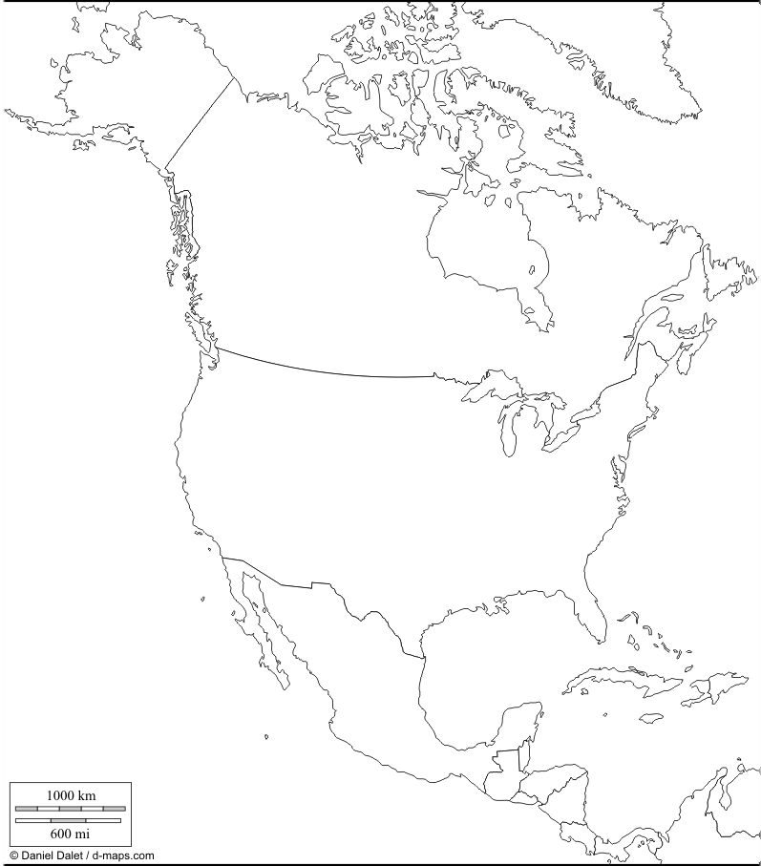
Alaska
Greenland
NORTH
AMERICA
Canada
America ( USA)
Mexico
Cuba
Westindies

Slide 18
Alasca
Canada
America
Cuba
Mexico
West Indies

Slide 19
SOUTH AMERICA

Slide 20
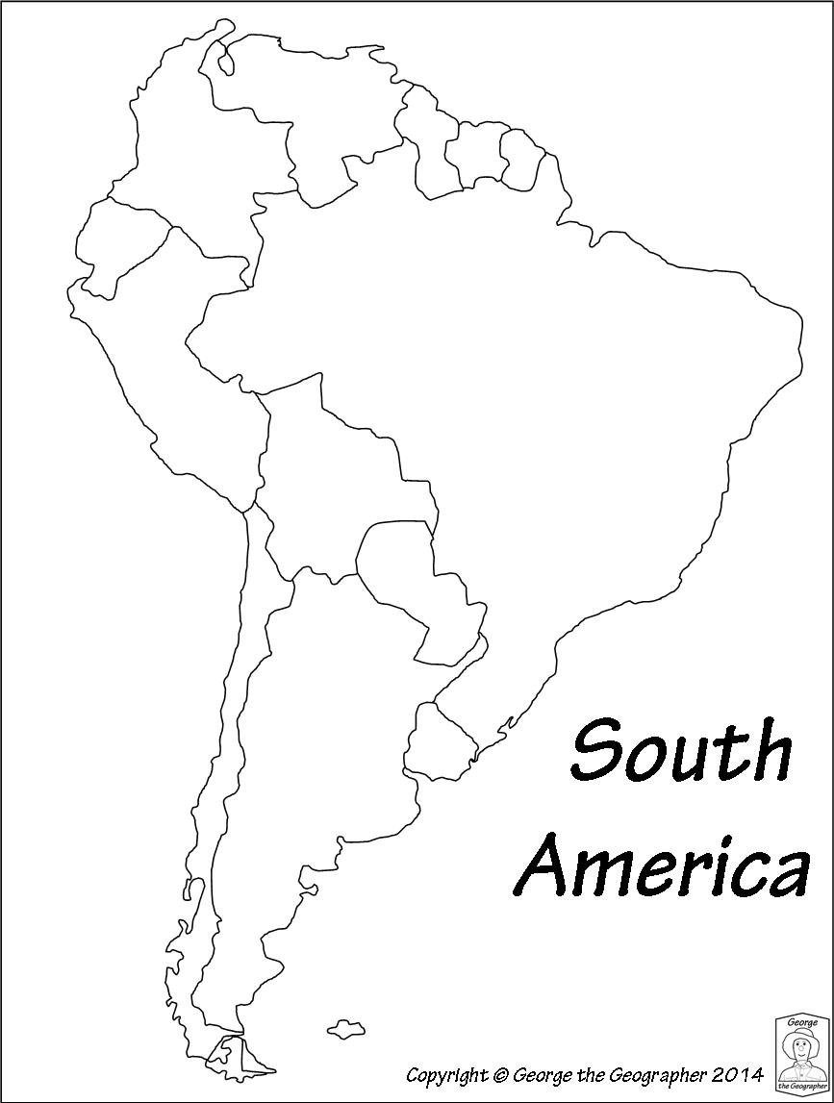
2. Argentina
3. Chile
4. Peru
5. Colombia
6. Ecuador
7. Venujula
8. Bolivia
9. Prague
10.Urugwe
11. Guyana
12. Surinam
13. French Gulana
5
7
11
12
13
1. Brazil
6
4
8
3
9
2
10
SOUTH
AMERICA

Slide 21
1. Brazil
2. Argentina
3. Chile
4. Peru
5. Colombia
6. Ecuador
7. Venujula
8. Bolivia
9. Prague
10.Urugwe
11. Guyana
12. Surinam
13. French Gulana
11
12
7
13
5
6
1
4
8
9
10
2
3

Slide 22
Important Countries

Slide 23
1. The country where Bandung conference held ( Indonesia)
2. The country where may 4th movement took place ( China)
3. The country where October revolution took place ( Russia)
4. The only colony of France in Asia (Vietnam)
5. The country where headquarter of UNO situated( America )
6. The country where headquarter of NATO located ( Belgium )
7. The leading country of Triple Entente ( Britain )
8. The leader of Triple Alliance (Germany)
9. Independent country in Africa (Ethiopia)

Slide 24
3. Russia
7.Britain
8. Germany
6. Belgium
5. America
2. China
9. Ethopia
4. Vietnam
1. Indonesia

Slide 25
10. The country which ruled Angola ( Portugal )
11. The country which ruled Nigeria ( Britain )
12. The leading country of socialist block ( Russia)
13. The leading country of capitalist block ( America )
14. The separate state for Jews people ( Israel )
15. The country which was not influenced by Great depression ( Russia )
16. The country which was influenced very high by Great depression ( Germany )
17. The country where Hiroshima, Nagasaki cities ( Japan )
18. The country which has The word ‘ Gender ‘ in its constitution preamble (Nepal)
19. The country which has The word ‘ Peace ‘ in its constitution preamble (Japan)

Slide 26
12. Russia
11. Britain
15. Russia
16. Germany
13. America
17. Japan
10. Portugal
18. Nepal
19. Japan
14. Israel

Slide 27
IMPORTANT CITIES

Slide 28
3.The Hague
6.Brassels
5.St.Peters burg
4.Bezing
1.Newyark
2.Geneva
1. The city where UNO headquarters situated
4. The city where may fourth movement occurred
2. The city where League of Nations headquarters situated
5. The city where March eighth movement occurred
3. The city where International court of justice situated
6. The city where headquarters of NATO situated

Slide 29
3. Masco
5. London
6. Belgrade
2.Washinghton
1.New Delhi
4.Tokyo
8
7
1. Capital city of India
4. Capital city of Japan
7. Bandung
2. Capital city of America
5. Capital city of Britain
8. Taiwan
3. Capital city of Russia
6. Capital city of Yugoslavia

Slide 30
SEAS

Slide 31
5
6
10
3
1
2
9
11
4
8
7
1. Black sea
5. Baltic sea
9. Yellow sea
2. Caspian sea
6. White sea
10. North sea
3. Adriatic sea
7. Red sea
11. Karabian sea
4. Meditarian sea
8. Arabian sea

Slide 32
STRAITS - GULFS

Slide 33
3
2
5
1
4
1. The strait separate India from Srilanka ( Palk Strait)
4. The Gulf between India and Srilanka
( Gulf of Manner)
2. The Strait between Europe and Africa ( Zebralter Strait)
3. The strait separate Asia from North America ( Bering Strait)
5. Gulf of Parissia

Slide 34
BAYS - CANALS

Slide 35
2
6
3
5
1
4
1. Bay of Bengal
4. Panama canal
6. English Chanal
2. Bay of Hudson
5. Suez Canal
3. Bay of Biscay

Slide 36
Thank You
www.digitalsocialteacher.in

